Slide 1
Galaxian Evidence - Part 1
Rodolfo Fava – 160204 Programming
Block A 2016

Slide 2
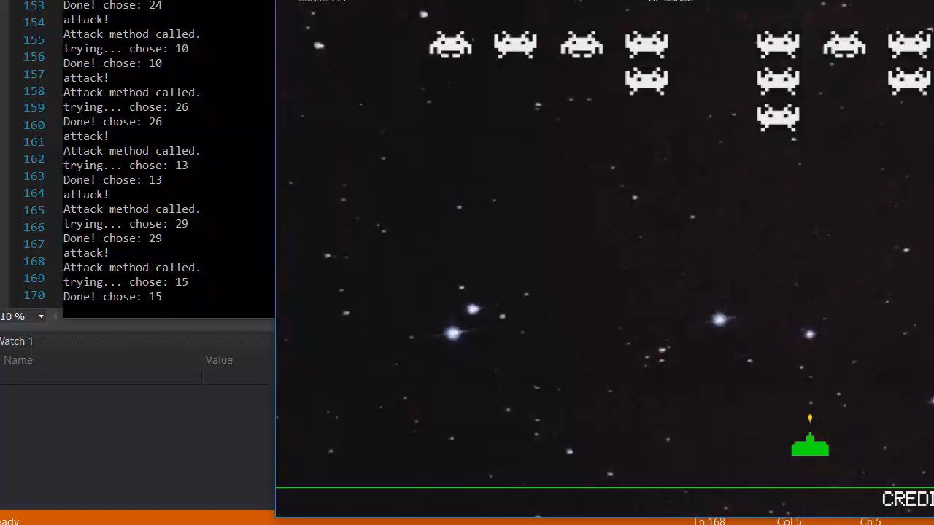
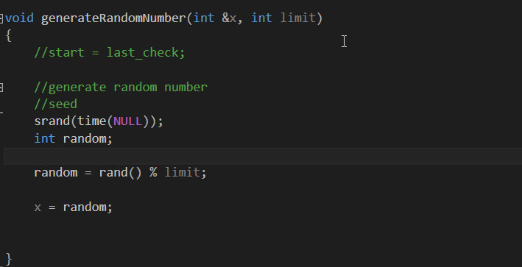
First Lag: Random selection
The lag
The code

Slide 3
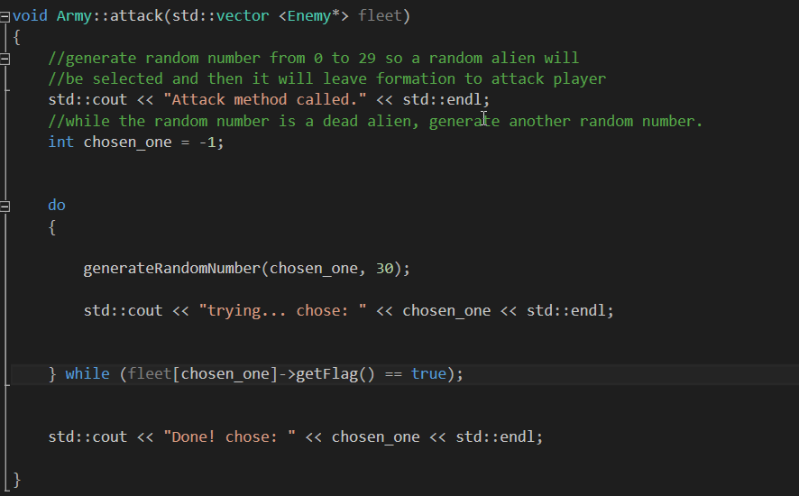
First Lag: Random selection
The call to the random # function
Explanation
according to the method attack body, the function generateRandomNumber would be called – by a do a while statement- until it yielded a number (equivalent to the index of the alien object with the vector of pointers to the class Enemy) whose flag, (related to the specific alien’s life status - if flag equals ‘true’, it means the alien is dead) would be false. In other words, until the randomly selected alien was dead, it would keep trying another random number. The problem with this code resides in the random # function, since its seed is time(NULL), every time the function is called within an interval of one second the random function would return the same value (which can be seen in the console window of the first video). This was fixed by simply removing the seed(time(NULL)) statement, as shown next.

Slide 4
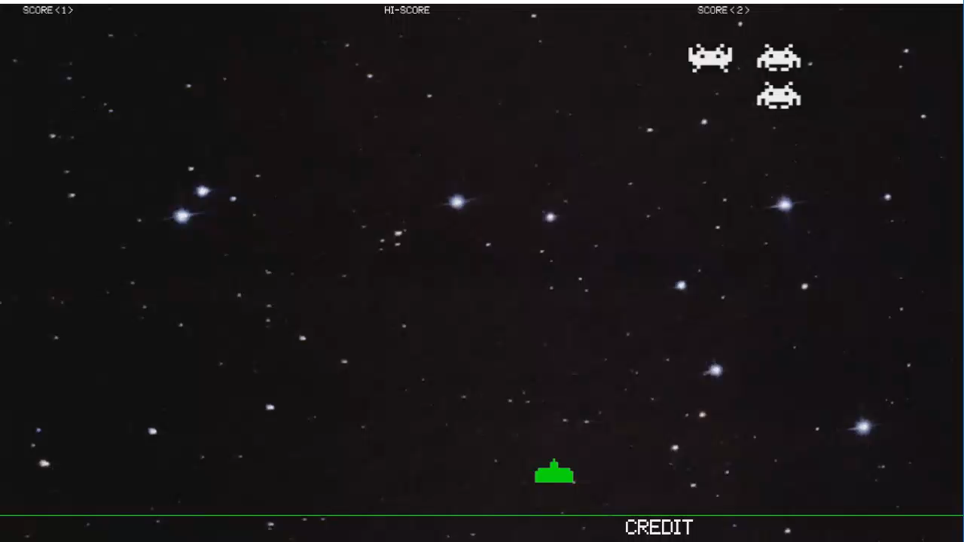
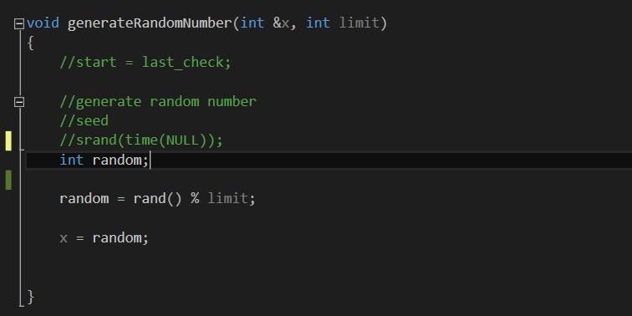
Fixing the first lag
random # method fixed
Result**
**Every 5 seconds a new alien is selected randomly. Before the fix, it would take a long time for the
program to find a random number that did not represent a dead alien, causing the game to stop.
The fact that the game now runs for 9 seconds nonstop proves the problem has been solved.

Slide 5
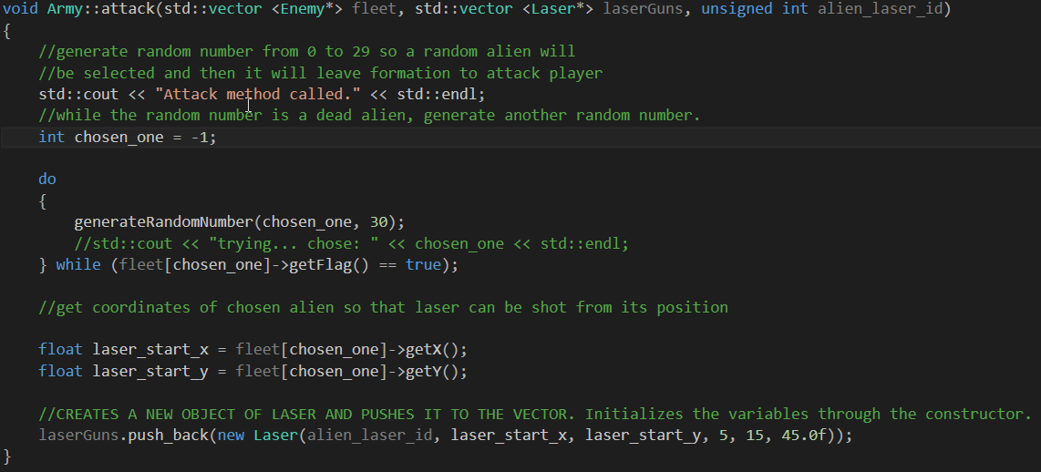
Aliens + Lasers = Trouble
Next, I wanted to create a vector of lasers that will eventually be shot from the aliens, taking the position of the alien at the moment it is shot as a starting point. So, I added a new parameter to the attack function.

Slide 6
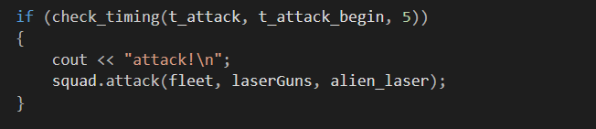
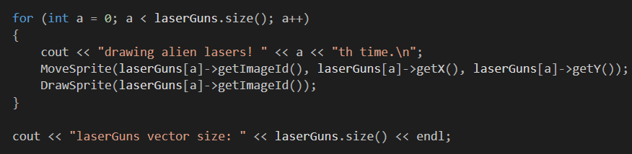
Aliens + Lasers = Trouble
Afterwards I realized none of the lasers were being printed. Then I decided to find out what was the actual size of the laserGuns vector. Zero. Finally, I realized it happened so because the attack method was merely making a copy of the original laserGuns vector – the parameter was being passed as a value- , and all the changes made in that copy would never affect the original. In the next slide, I demonstrate how I fixed the issue.

Slide 7
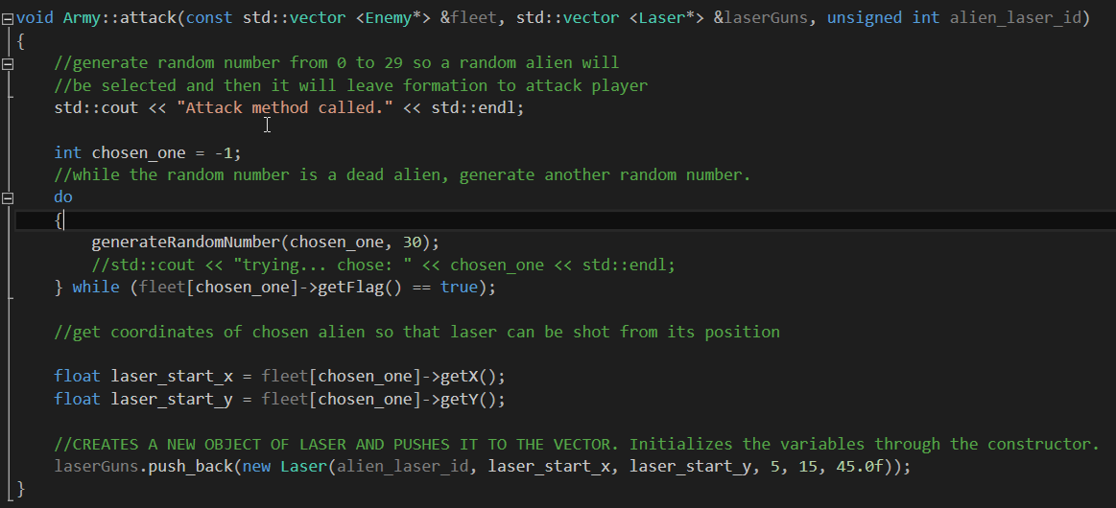
Aliens + Lasers = Nailed
As highlighted in the picture to the left, I simply added and & to the left of the vector name laserGuns, what completely changed the way the function handled the vector. Now, it is being treated as an alias to the original vector, that is, laserGuns is being passed as a reference. That means I can make whatever changes we like to laserGuns that it will affect the original, besides sparing the computer from making a copy of n objects inside the vector. For that second reason, I also changed added & to fleet, besides making it const, so no data inside it suffers unwanted change by a function which merely reads it.

Slide 8
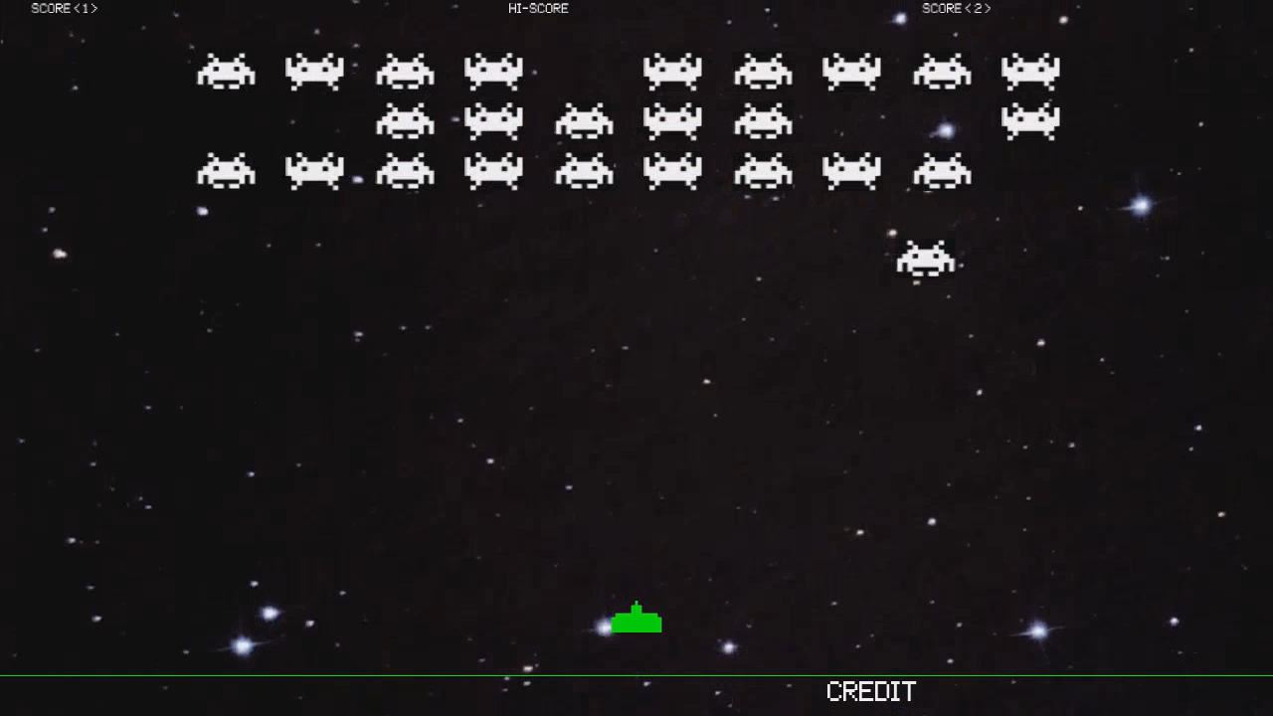
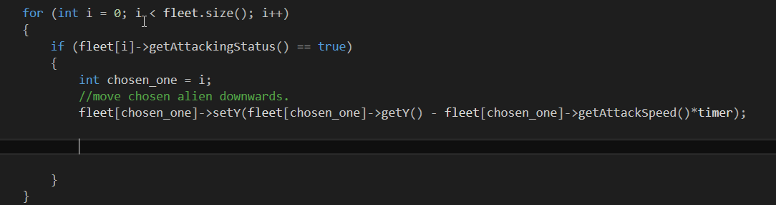
Aliens attacking in 3 steps
Footage of aliens deserting their army
1- Leaving formation, but never coming back.

Slide 9
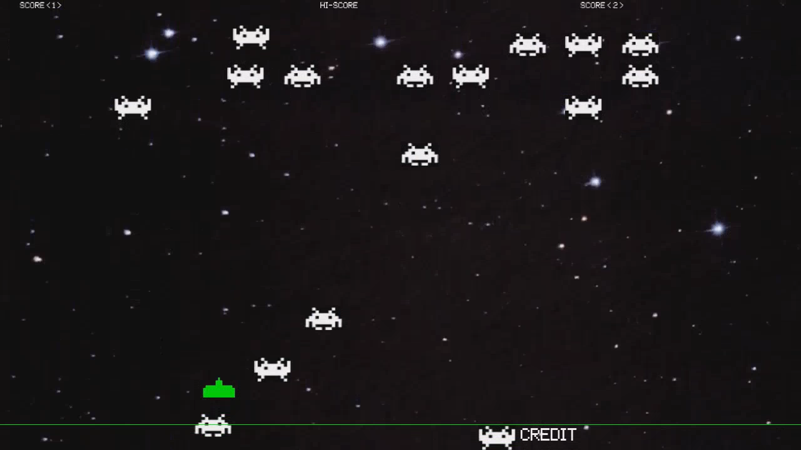
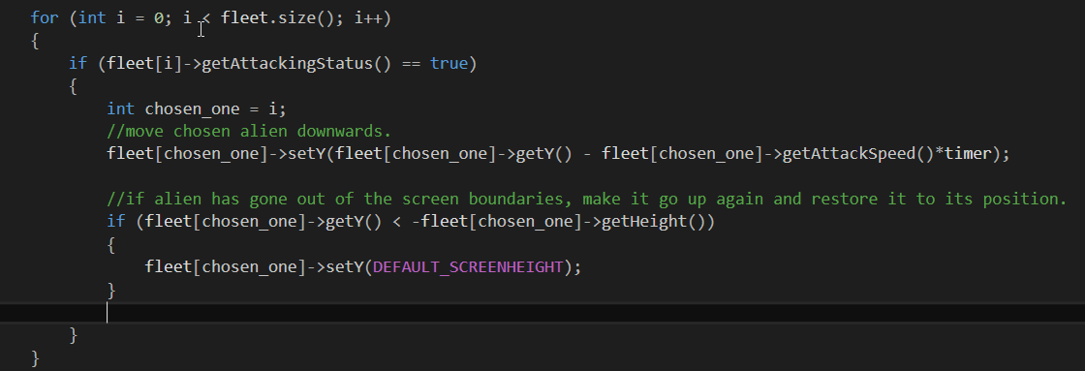
Aliens attacking in 3 steps
Footage of aliens on adrenaline rush
2- Leaving formation, going back to the top, repeat

Slide 10
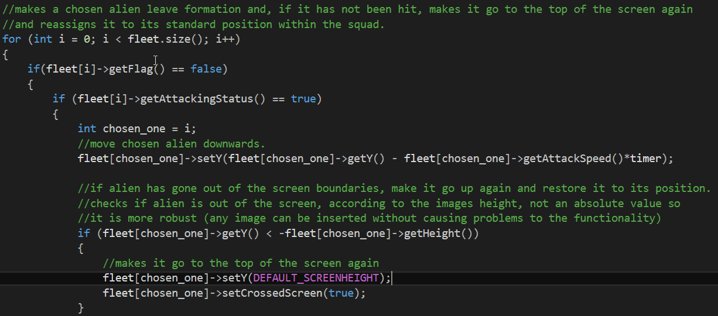
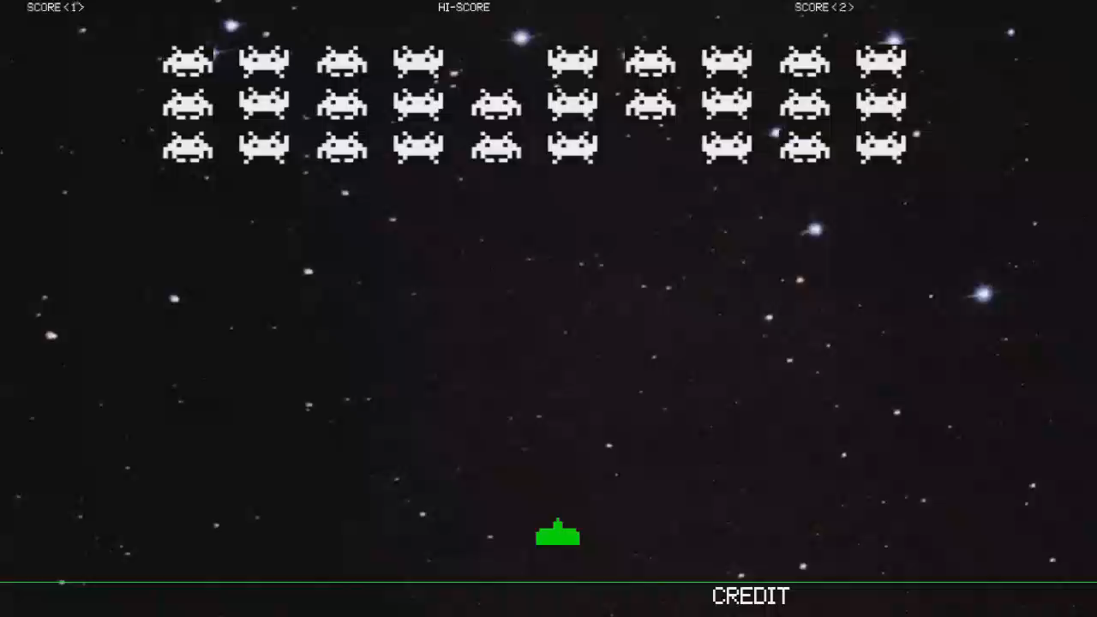
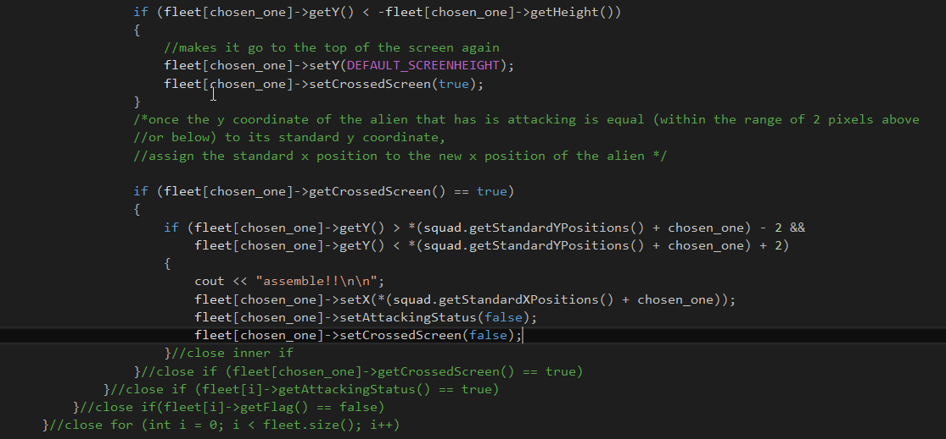
Aliens attacking in 3 steps
3 - Leaving formation, going back to the top, returning to standard position in the squad
Footage of disciplined aliens

